Slide 1

GROUP E
INSTALLATION OF C AND C++ -through Ubuntu terminal
BY Sathosh Kumar
Syed Waqeer
Thanu Priya
Prateek Srivastava

Slide 2
INSTALLATION OF C++
HOW IT WILL WORK ON TERMINAL
OUTPUT

Slide 3
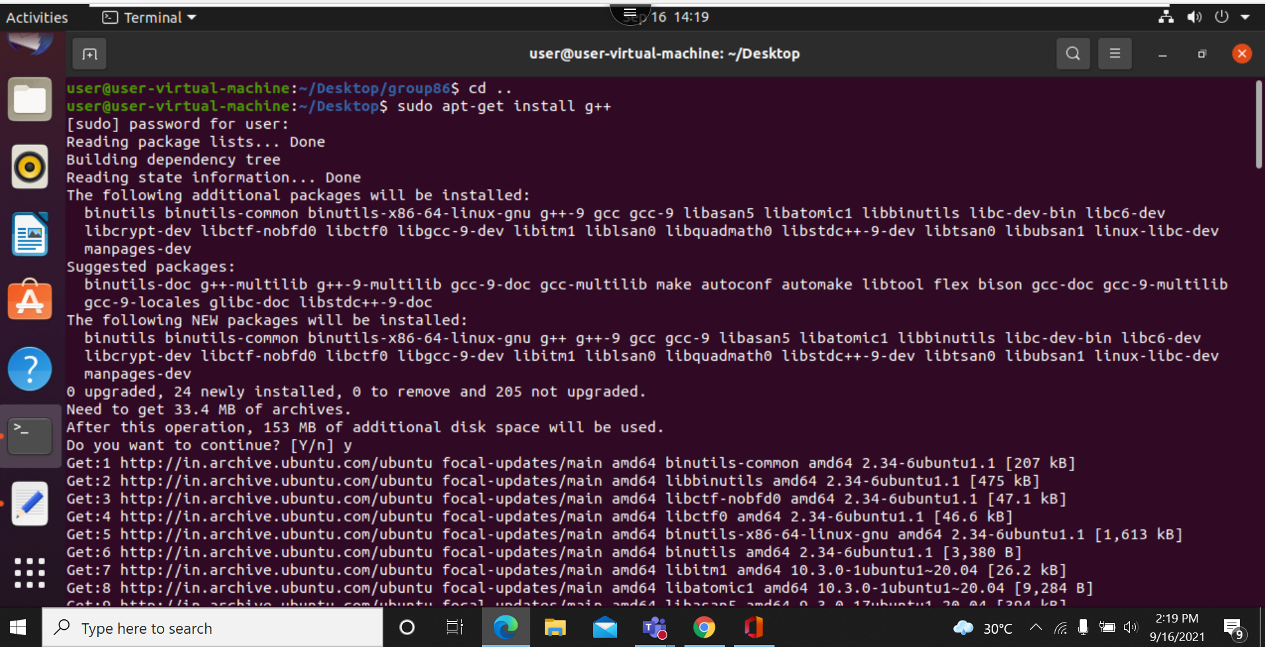

Slide 4
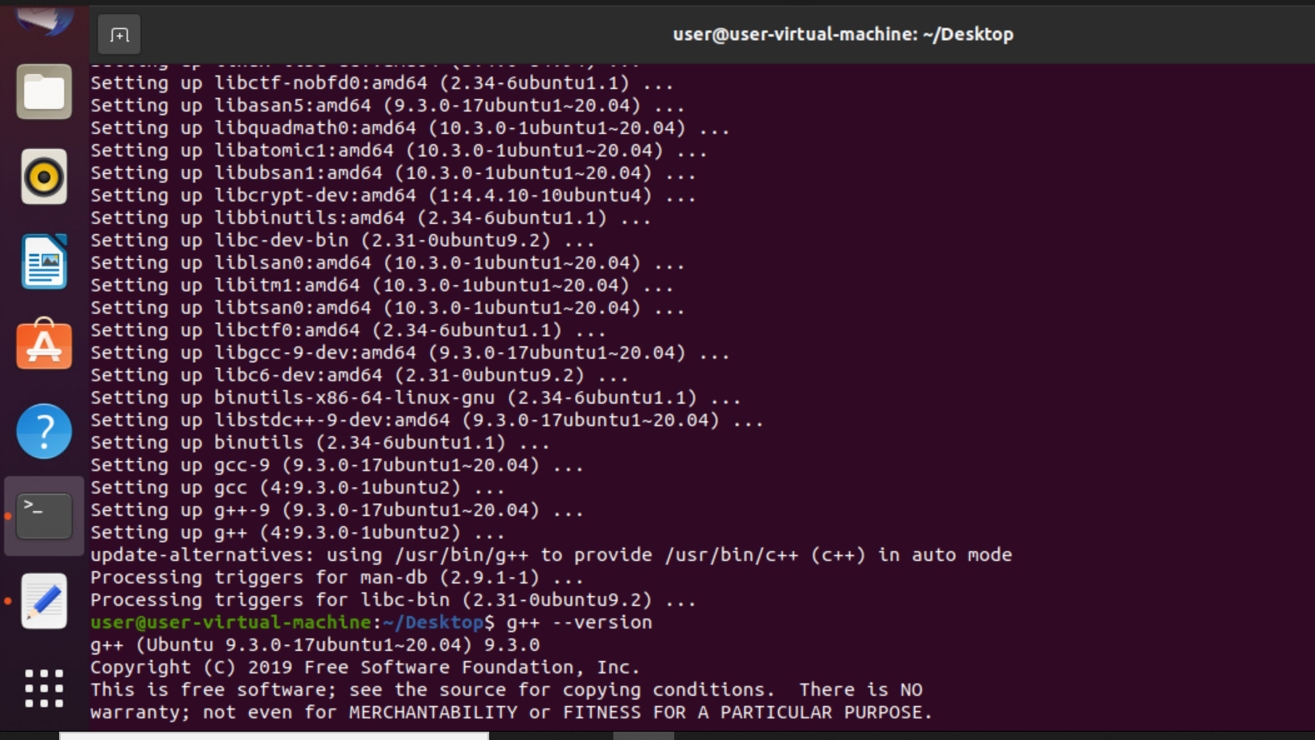
Sudo apt-get install g++
g++ --version (for checking the version)

Slide 5
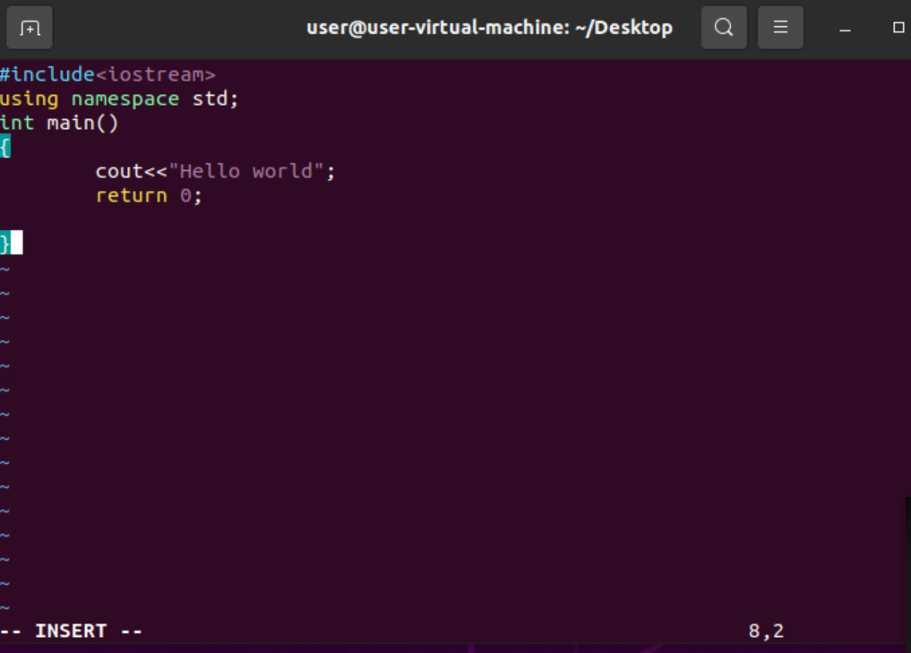
Touch filename.cpp

Slide 6
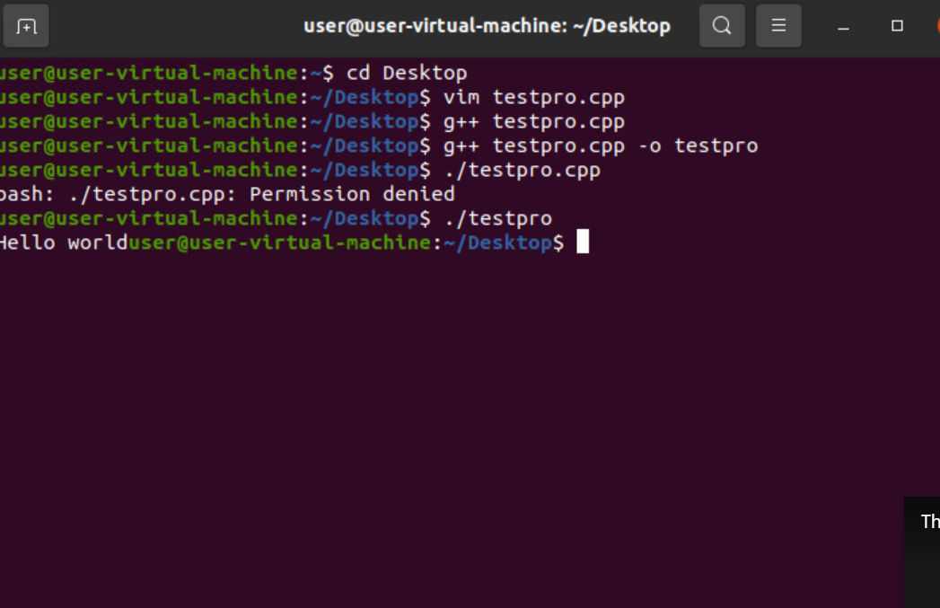
g++ filename.cpp -o filename
./filename

